Slide 1
EEID Ant Grant
Research Presentation
Meridith Bartley
Statistics Department
Advisor: Ephraim Hanks

Slide 2
Project Summary
Data includes two, four and twelve hours of continuous ant trophallaxis observations
High density (1 chamber) & low density (4 chambers)
4 hour forager entrance times also obtained
Discrete time, hidden state MCMC Model used to identify two - state rate switching occurrences at colony level
three state model also considered and discarded
Future work: explore interaction model at individual level
Covariates: distance to nearest ant, time since forager entered chamber

Slide 3
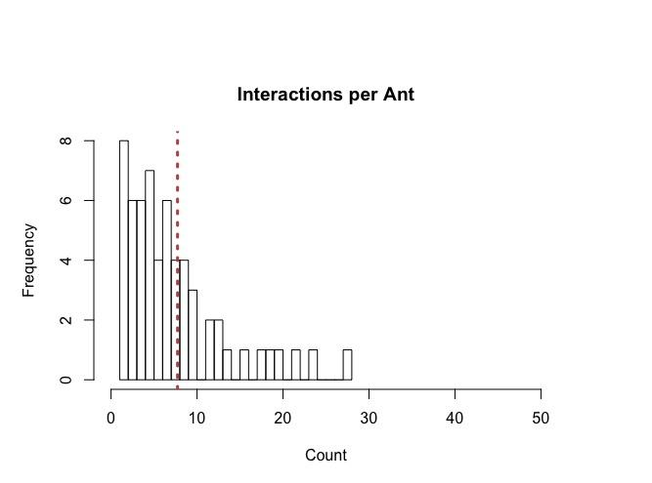
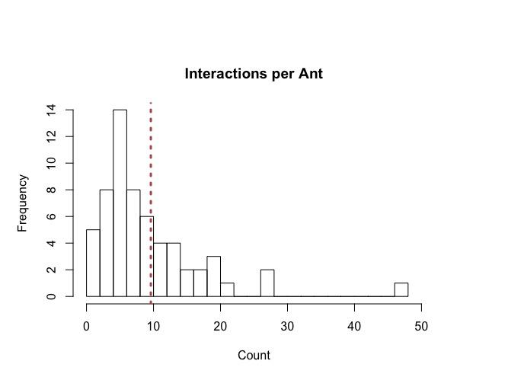
Number of Interactions per Ant - 2 Hours
High Density
Low Density

Slide 4
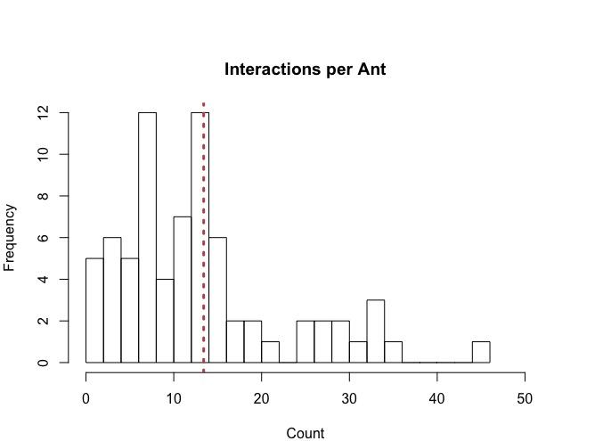
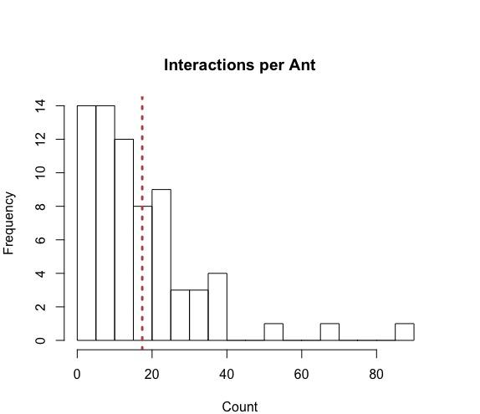
Number of Interactions per Ant - 4 Hours
High Density
Low Density

Slide 5
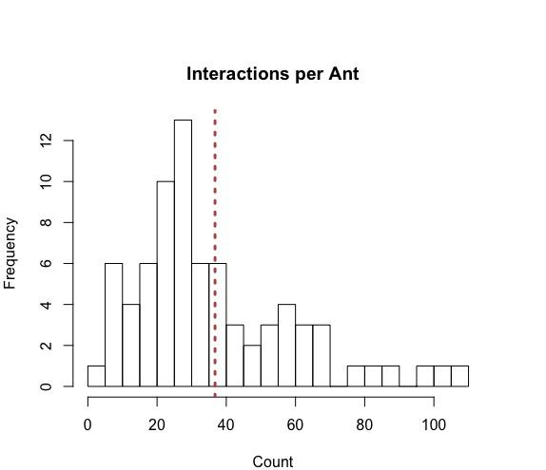
Number of Interactions per Ant - 12 Hours

Slide 6
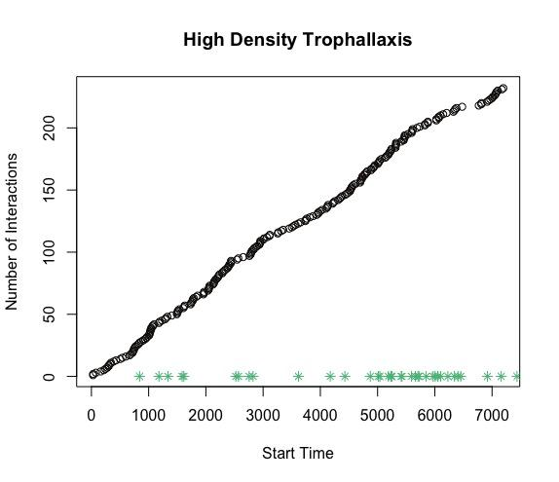
Interactions Over Time - 2 Hours

Slide 7
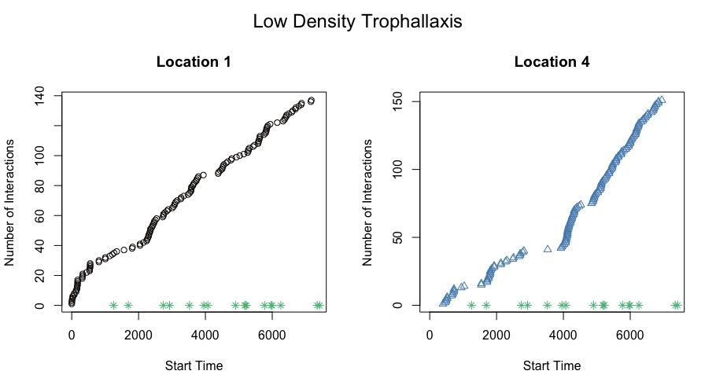
Interactions Over Time - 2 Hours

Slide 8
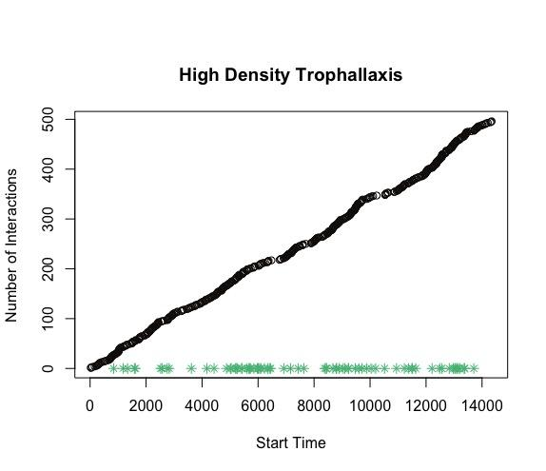
Interactions Over Time - 4 Hours

Slide 9
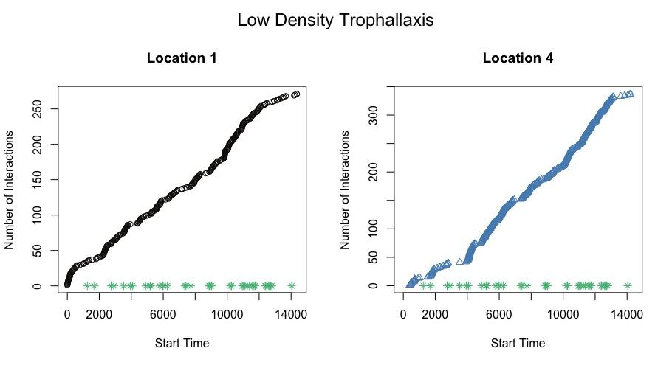
Interactions Over Time - 4 Hours

Slide 10
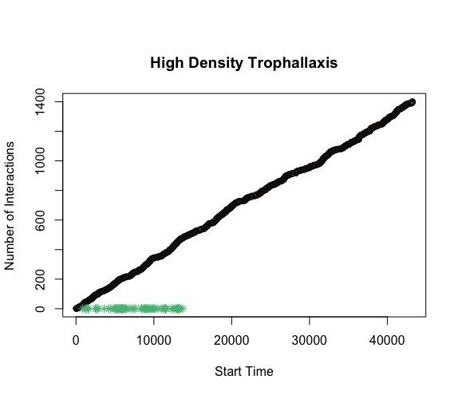
Interactions Over Time - 12 Hours

Slide 11
Hidden Markov Model for Trophallaxis Interactions
Observed Interactions: N_{t}∼Pois(λ_{Xt}) Unobserved States: X_{t}| X_{t−1} ∼ Multinom(1, p_{Xt−1}) where, P =
λ_{Xt}∼Gamma(α,β) p_{Xt}∼Dirichlet(θ)
p₁₁ | p₁₂
p₂₁ | p₂₂

Slide 12
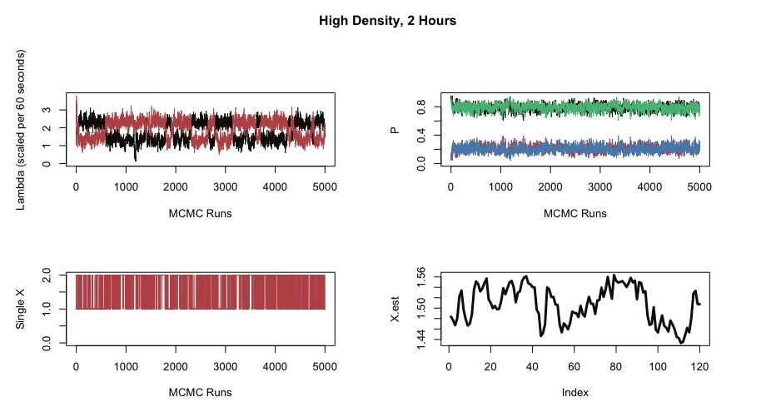
MCMC - High Density, 2 Hours

Slide 13
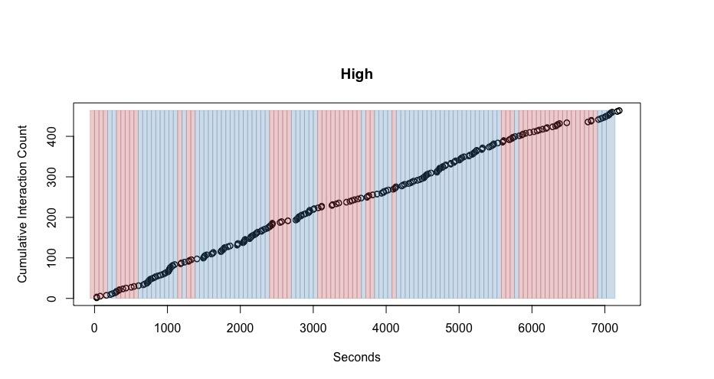
Predicted Trophallaxis Rates - High Density, 2 Hours

Slide 14
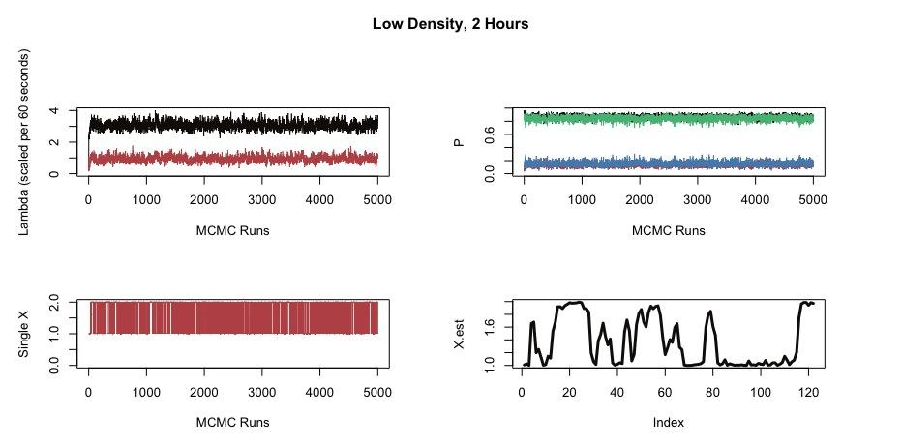
MCMC - Low Density, 2 Hours

Slide 15
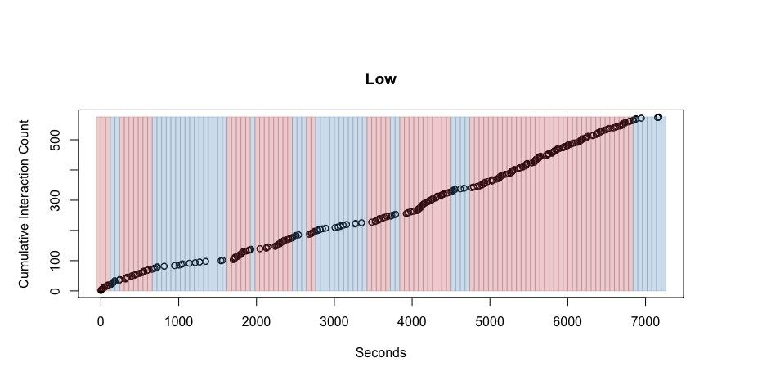
Predicted Trophallaxis Rates - Low Density, 2 Hours

Slide 16
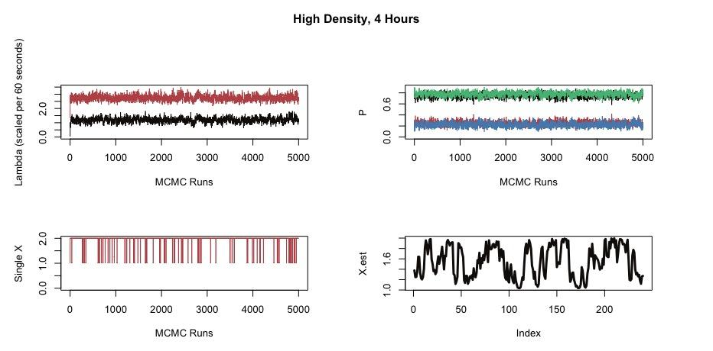
MCMC - High Density, 4 Hours

Slide 17
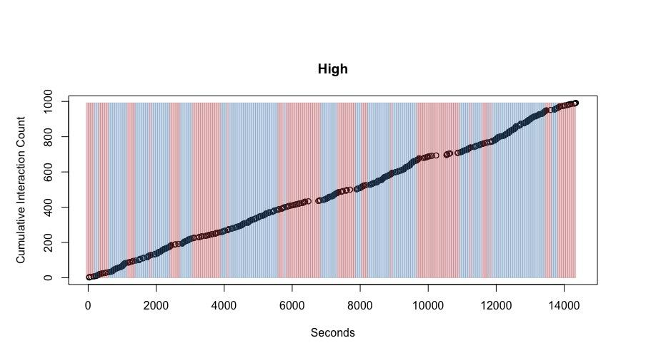
Predicted Trophallaxis Rates - High Density, 4 Hours

Slide 18
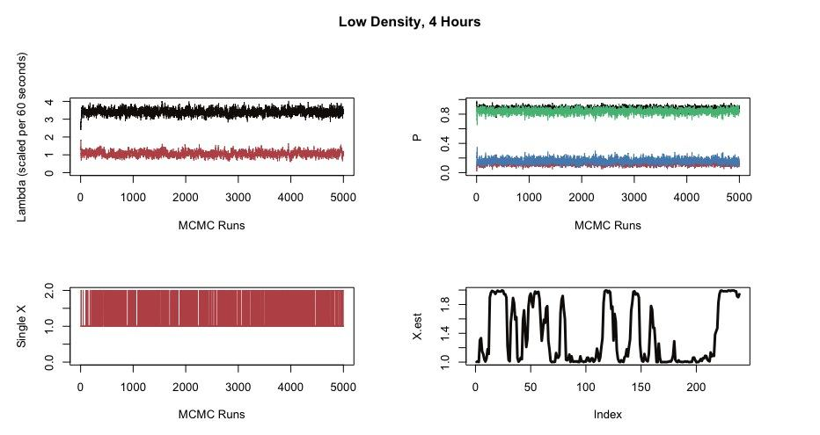
MCMC - Low Density, 4 Hours

Slide 19
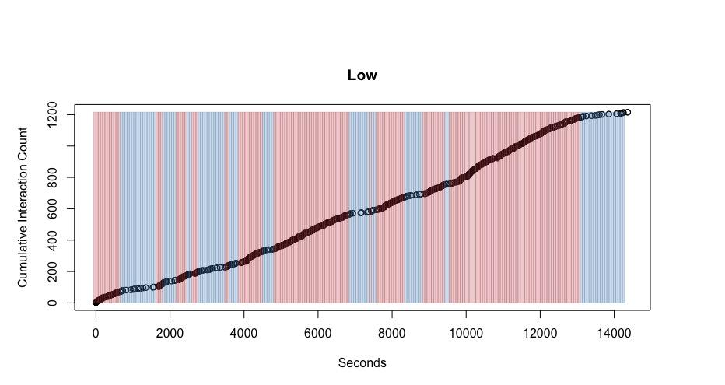
Predicted Trophallaxis Rates - Low Density, 4 Hours

Slide 20
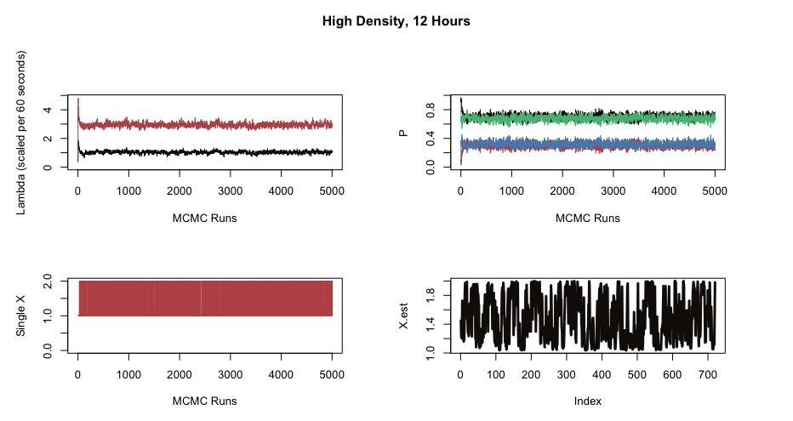
MCMC - High Density, 12 Hours

Slide 21
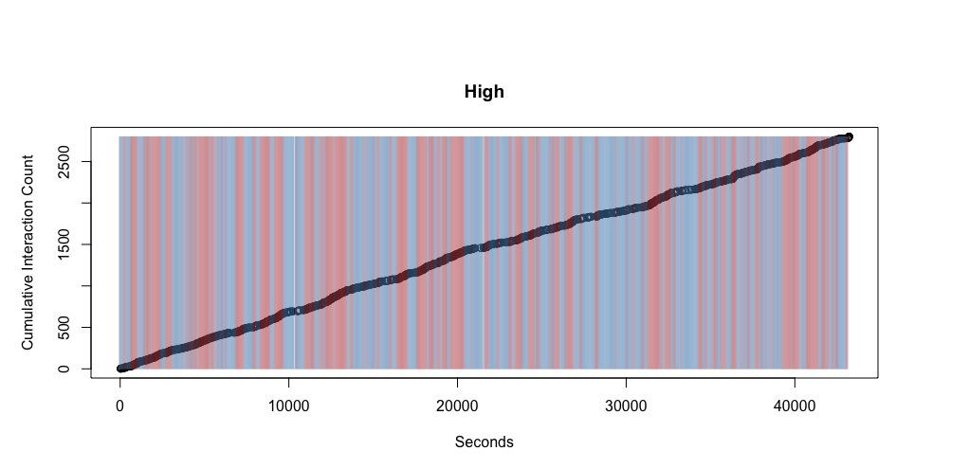
Predicted Trophallaxis Rates - High Density, 12 Hours

Slide 22
Hidden Markov Model with Covariates
Observed Interactions, Entrances Times: N_{t} ∼ Pois(λ_{Xt}), W_{t}
Unobserved States: X_{t}| X_{t−1} ∼ Multinom(1, p_{Xt−1}(α, β)) λ_{Xt}∼Gamma(a, b)
P_{1,2}^{t} = e^{β_0 + β_1 * w_t} / (1 + e^{β_0 + β_1 * W_t})
P_{1, 1} ^{t} = 1 - P_{1,2}^{t}
P_{2, 1} ^{t} = e^{α} / (1 + e^{α})
P_{2,2}^{t} = 1 - P_{2,1}^{t}

